Slide 1
Tap-Tap Search
Specathon 2k21
Team Members:
A. Sreshta
Deepika Annaboyina
Alla Supriya
Murki Shravani
Team Name:
Revolutionizers

Slide 2
Tap-Tap Search
An android application which converts speech to text, text to speech file to speech, image to speech and reads out to the user.
Also, notification reader can be implemented where if the user receives any text message from any one then it will tell what message has been received and from whom.
The development of a text to speech synthesizer will be of great help to people with visual impairment and make going through large volumes of text easier.
It can also help them involve themselves in communicating with others without getting bored.

Slide 3
Technology Stack
Operating System: Windows 10 (64 bit)
IDE: Android Studio 3
Technologies: Java
Other Technologies : Optical Character Recognition(OCR),Text To Speech(TTS)

Slide 4
Modules
Home page
Text to Speech
Speech to Text
File to Speech
Image to Speech

Slide 5
Progress
Completed:
Text to Speech
Speech to Text
Image to Speech
File to Speech - Only Text files.
Working on Notification Reader.

Slide 6
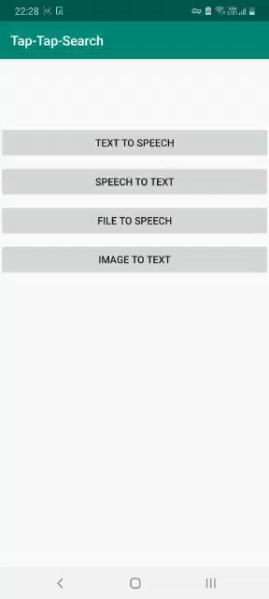
Demo Video

Slide 7


